Slide 1

Hi-Landers Ham Class
Instructed by Rich Bugarin W6EC

Slide 2
Sub-element 4 of 10

Slide 3
Ham Radio Technician Class Exam preparation Power Point created by Rich Bugarin W6EC.
Effective July 1, 2022 and is valid until June 30, 2026.
Please send suggested changes to this presentation to:
w6ec@thebugarins.com

Slide 4
Study Hints
I suggest you read each question and only the correct answer. Read through the complete question pool at least three times before you attempt taking a practice exams. For higher impact and better results read the correct answer first then the question and again the correct answer.
The key to passing the exam is to get the most questions correct using the above method the correct response will often jump out at you on test day even if you don’t remember the question.

Slide 5
Text Color
Black: Original/Official questions and information in original format (unaltered).
Red: Original information text color simply changed to highlight subject.
Blue: Notes and information added by Rich (W6EC).

Slide 6
SUBELEMENT T4 – AMATEUR RADIO PRACTICES
[2 Exam Questions - 2 Groups]

Slide 7
T4A – Station setup: connecting a microphone, a power source, a computer, digital equipment, an SWR meter; bonding; Mobile radio installation
#13 of 35

Slide 8
T4A01
Which of the following is an appropriate power supply rating for a typical 50 watt output mobile FM transceiver?
A. 24.0 volts at 4 amperes
B. 13.8 volts at 4 amperes
C. 24.0 volts at 12 amperes
D. 13.8 volts at 12 amperes

Slide 9
T4A01
Which of the following is an appropriate power supply rating for a typical 50 watt output mobile FM transceiver?
A. 24.0 volts at 4 amperes
B. 13.8 volts at 4 amperes
C. 24.0 volts at 12 amperes
D. 13.8 volts at 12 amperes
Amps = Watts divided Volts.
Here 50 watts needs about 5 amps @ 12V The power supply needs to be bigger than minimum required.

Slide 10
T4A02
Which of the following should be considered when selecting an accessory SWR meter?
A. The frequency and power level at which the measurements will be made
B. The distance that the meter will be located from the antenna
C. The types of modulation being used at the station
D. All these choices are correct

Slide 11
T4A02
Which of the following should be considered when selecting an accessory SWR meter?
A. The frequency and power level at which the measurements will be made
B. The distance that the meter will be located from the antenna
C. The types of modulation being used at the station
D. All these choices are correct

Slide 12
T4A03
Why are short, heavy-gauge wires used for a transceiver’s DC power connection?
A. To minimize voltage drop when transmitting
B. To provide a good counterpoise for the antenna
C. To avoid RF interference
D. All these choices are correct

Slide 13
T4A03
Why are short, heavy-gauge wires used for a transceiver’s DC power connection?
A. To minimize voltage drop when transmitting
B. To provide a good counterpoise for the antenna
C. To avoid RF interference
D. All these choices are correct

Slide 14
T4A04
How are the transceiver audio input and output connected in a station configured to operate using FT8?
A. To a computer running a terminal program and connected to a terminal node controller unit
B. To the audio input and output of a computer running WSJT-X software
C. To an FT8 conversion unit, a keyboard, and a computer monitor
D. To a computer connected to the FT8converter.com website

Slide 15
T4A04
How are the transceiver audio input and output connected in a station configured to operate using FT8?
A. To a computer running a terminal program and connected to a terminal node controller unit
B. To the audio input and output of a computer running WSJT-X software
C. To an FT8 conversion unit, a keyboard, and a computer monitor
D. To a computer connected to the FT8converter.com website (See next slide)

Slide 16
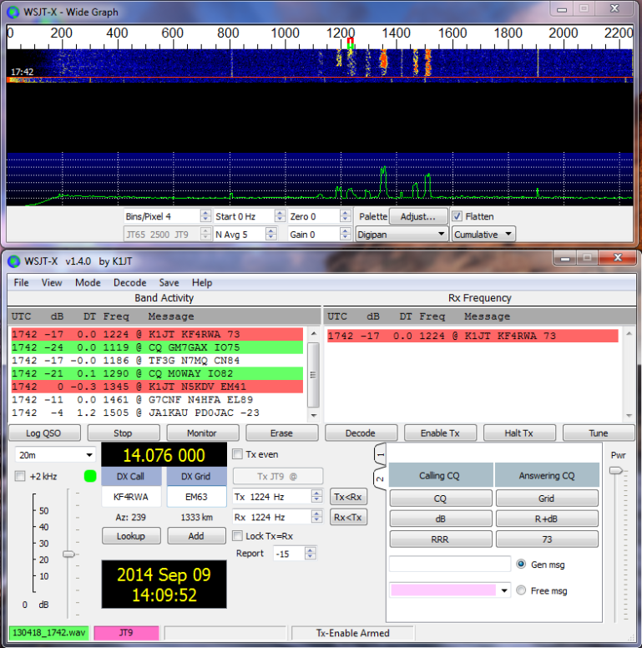
What is FT8?
FT8 is one of the many digital modes often referred to as sound card modes (SCM) because they utilize a computer’s sound card to bring in audio from your radio to be processed by software to decode the information embedded in the signal. Conversely, when you want to transmit, the software encodes your message into audio tones that are sent out via your sound card to your radio’s audio or Mic input.
Screen shot of WSJT-X software

Slide 17
T4A05
Where should an RF power meter be installed?
A. In the feed line, between the transmitter and antenna
B. At the power supply output
C. In parallel with the push-to-talk line and the antenna
D. In the power supply cable, as close as possible to the radio

Slide 18
T4A05
Where should an RF power meter be installed?
A. In the feed line, between the transmitter and antenna
B. At the power supply output
C. In parallel with the push-to-talk line and the antenna
D. In the power supply cable, as close as possible to the radio

Slide 19
T4A06
What signals are used in a computer-radio interface for digital mode operation?
A. Receive and transmit mode, status, and location
B. Antenna and RF power
C. Receive audio, transmit audio, and transmitter keying
D. NMEA GPS location and DC power

Slide 20
T4A06
What signals are used in a computer-radio interface for digital mode operation?
A. Receive and transmit mode, status, and location
B. Antenna and RF power
C. Receive audio, transmit audio, and transmitter keying
D. NMEA GPS location and DC power

Slide 21
T4A07
Which of the following connections is made between a computer and a transceiver to use computer software when operating digital modes?
A. Computer “line out” to transceiver push-to-talk
B. Computer “line in” to transceiver push-to-talk
C. Computer “line in” to transceiver speaker connector
D. Computer “line out” to transceiver speaker connector

Slide 22
T4A07
Which of the following connections is made between a computer and a transceiver to use computer software when operating digital modes?
A. Computer “line out” to transceiver push-to-talk
B. Computer “line in” to transceiver push-to-talk
C. Computer “line in” to transceiver speaker connector (Speaker out)
D. Computer “line out” to transceiver speaker connector

Slide 23
T4A08
Which of the following conductors is preferred for bonding at RF?
A. Copper braid removed from coaxial cable
B. Steel wire
C. Twisted-pair cable
D. Flat copper strap

Slide 24
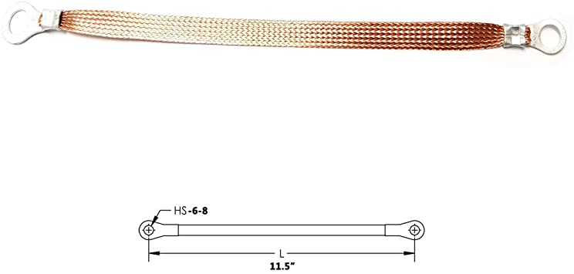
T4A08
Which of the following conductors is preferred for bonding at RF?
A. Copper braid removed from coaxial cable
B. Steel wire
C. Twisted-pair cable
D. Flat copper strap
Bonding is AKA Grounding

Slide 25
T4A09
How can you determine the length of time that equipment can be powered from a battery?
A. Divide the watt-hour rating of the battery by the peak power consumption of the equipment
B. Divide the battery ampere-hour rating by the average current draw of the equipment
C. Multiply the watts per hour consumed by the equipment by the battery power rating
D. Multiply the square of the current rating of the battery by the input resistance of the equipment

Slide 26
T4A09
How can you determine the length of time that equipment can be powered from a battery?
A. Divide the watt-hour rating of the battery by the peak power consumption of the equipment
B. Divide the battery ampere-hour rating by the average current draw of the equipment
C. Multiply the watts per hour consumed by the equipment by the battery power rating
D. Multiply the square of the current rating of the battery by the input resistance of the equipment

Slide 27
T4A10
What function is performed with a transceiver and a digital mode hot spot?
A. Communication using digital voice or data systems via the internet
B. FT8 digital communications via AFSK
C. RTTY encoding and decoding without a computer
D. High-speed digital communications for meteor scatter

Slide 28
T4A10
What function is performed with a transceiver and a digital mode hot spot?
A. Communication using digital voice or data systems via the internet
B. FT8 digital communications via AFSK
C. RTTY encoding and decoding without a computer
D. High-speed digital communications for meteor scatter

Slide 29
T4A11
Where should the negative power return of a mobile transceiver be connected in a vehicle?
A. At the 12 volt battery chassis ground
B. At the antenna mount
C. To any metal part of the vehicle
D. Through the transceiver’s mounting bracket

Slide 30
T4A11
Where should the negative power return of a mobile transceiver be connected in a vehicle?
A. At the 12 volt battery chassis ground
B. At the antenna mount
C. To any metal part of the vehicle
D. Through the transceiver’s mounting bracket

Slide 31
T4A12
What is an electronic keyer?
A. A device for switching antennas from transmit to receive
B. A device for voice activated switching from receive to transmit
C. A device that assists in manual sending of Morse code
D. An interlock to prevent unauthorized use of a radio

Slide 32
T4A12
What is an electronic keyer?
A. A device for switching antennas from transmit to receive
B. A device for voice activated switching from receive to transmit
C. A device that assists in manual sending of Morse code
D. An interlock to prevent unauthorized use of a radio

Slide 33
T4B - Operating controls: frequency tuning, use of filters, squelch function, AGC, memory channels, noise blanker, microphone gain, receiver incremental tuning (RIT), bandwidth selection, digital transceiver configuration
#14 of 35

Slide 34
T4B01
What is the effect of excessive microphone gain on SSB transmissions?
A. Frequency instability
B. Distorted transmitted audio
C. Increased SWR
D. All these choices are correct

Slide 35
T4B01
What is the effect of excessive microphone gain on SSB transmissions?
A. Frequency instability
B. Distorted transmitted audio
C. Increased SWR
D. All these choices are correct

Slide 36
T4B02
Which of the following can be used to enter a transceiver’s operating frequency?
A. The keypad or VFO knob
B. The CTCSS or DTMF encoder
C. The Automatic Frequency Control
D. All these choices are correct

Slide 37
T4B02
Which of the following can be used to enter a transceiver’s operating frequency?
A. The keypad or VFO knob
B. The CTCSS or DTMF encoder
C. The Automatic Frequency Control
D. All these choices are correct
VFO = Variable Frequency Oscillator (or Operation) named for the circuit that tunes the radio to different frequencies.

Slide 38
T4B03
How is squelch adjusted so that a weak FM signal can be heard?
A. Set the squelch threshold so that receiver output audio is on all the time
B. Turn up the audio level until it overcomes the squelch threshold
C. Turn on the anti-squelch function
D. Enable squelch enhancement

Slide 39
T4B03
How is squelch adjusted so that a weak FM signal can be heard?
A. Set the squelch threshold so that receiver output audio is on all the time
B. Turn up the audio level until it overcomes the squelch threshold
C. Turn on the anti-squelch function
D. Enable squelch enhancement
Squelch is the circuit that quiets (Hides) background noise

Slide 40
T4B04
What is a way to enable quick access to a favorite frequency or channel on your transceiver?
A. Enable the frequency offset
B. Store it in a memory channel
C. Enable the VOX
D. Use the scan mode to select the desired frequency

Slide 41
T4B04
What is a way to enable quick access to a favorite frequency or channel on your transceiver?
A. Enable the frequency offset
B. Store it in a memory channel
C. Enable the VOX
D. Use the scan mode to select the desired frequency

Slide 42
T4B05
What does the scanning function of an FM transceiver do?
A. Checks incoming signal deviation
B. Prevents interference to nearby repeaters
C. Tunes through a range of frequencies to check for activity
D. Checks for messages left on a digital bulletin board

Slide 43
T4B05
What does the scanning function of an FM transceiver do?
A. Checks incoming signal deviation
B. Prevents interference to nearby repeaters
C. Tunes through a range of frequencies to check for activity
D. Checks for messages left on a digital bulletin board

Slide 44
T4B06
Which of the following controls could be used if the voice pitch of a single-sideband signal returning to your CQ call seems too high or low?
A. The AGC or limiter
B. The bandwidth selection
C. The tone squelch
D. The RIT or Clarifier

Slide 45
T4B06
Which of the following controls could be used if the voice pitch of a single-sideband signal returning to your CQ call seems too high or low?
A. The AGC or limiter
B. The bandwidth selection
C. The tone squelch
D. The RIT or Clarifier RIT = Receive Incremental Tuning (Receive Fine Tuning)

Slide 46
T4B07
What does a DMR “code plug” contain?
A. Your call sign in CW for automatic identification
B. Access information for repeaters and talkgroups
C. The codec for digitizing audio
D. The DMR software version

Slide 47
T4B07
What does a DMR “code plug” contain?
A. Your call sign in CW for automatic identification
B. Access information for repeaters and talkgroups
C. The codec for digitizing audio
D. The DMR software version
A Code Plug is a fancy name for the software file (program) that downloads data into your radio to tell it what to do.

Slide 48
T4B08
What is the advantage of having multiple receive bandwidth choices on a multimode transceiver?
A. Permits monitoring several modes at once by selecting a separate filter for each mode
B. Permits noise or interference reduction by selecting a bandwidth matching the mode
C. Increases the number of frequencies that can be stored in memory
D. Increases the amount of offset between receive and transmit frequencies

Slide 49
T4B08
What is the advantage of having multiple receive bandwidth choices on a multimode transceiver?
A. Permits monitoring several modes at once by selecting a separate filter for each mode
B. Permits noise or interference reduction by selecting a bandwidth matching the mode
C. Increases the number of frequencies that can be stored in memory
D. Increases the amount of offset between receive and transmit frequencies (See next slide)

Slide 50
Bandwidth
In electronics is the range of frequencies occupied by a modulated radio-frequency signal, usually given in hertz (cycles per second) For example, an AM station operating at 1,000,000 hertz has a bandwidth of 10,000 hertz, or 1 percent.
The term also designates the frequency range that an electronic device, such as an amplifier or filter, will transmit
VHF (2 Meter) Typically uses Wide Band Width @ 25 MHz spacing but Narrow Band Width @ 12.5 MHz spacing is available on newer radios.

Slide 51
T4B09
How is a specific group of stations selected on a digital voice transceiver?
A. By retrieving the frequencies from transceiver memory
B. By enabling the group’s CTCSS tone
C. By entering the group’s identification code
D. By activating automatic identification

Slide 52
T4B09
How is a specific group of stations selected on a digital voice transceiver?
A. By retrieving the frequencies from transceiver memory
B. By enabling the group’s CTCSS tone
C. By entering the group’s identification code
D. By activating automatic identification

Slide 53
T4B10
Which of the following receiver filter bandwidths provides the best signal-to-noise ratio for SSB reception?
A. 500 Hz
B. 1000 Hz
C. 2400 Hz
D. 5000 Hz

Slide 54
T4B10
Which of the following receiver filter bandwidths provides the best signal-to-noise ratio for SSB reception?
A. 500 Hz
B. 1000 Hz
C. 2400 Hz
D. 5000 Hz

Slide 55
T4B11
Which of the following must be programmed into a D-STAR digital transceiver before transmitting?
A. Your call sign
B. Your output power
C. The codec type being used
D. All these choices are correct

Slide 56
T4B11
Which of the following must be programmed into a D-STAR digital transceiver before transmitting?
A. Your call sign
B. Your output power
C. The codec type being used
D. All these choices are correct

Slide 57
T4B12
What is the result of tuning an FM receiver above or below a signal’s frequency?
A. Change in audio pitch
B. Sideband inversion
C. Generation of a heterodyne tone
D. Distortion of the signal’s audio

Slide 58
T4B12
What is the result of tuning an FM receiver above or below a signal’s frequency?
A. Change in audio pitch
B. Sideband inversion
C. Generation of a heterodyne tone
D. Distortion of the signal’s audio

Slide 59
End of Sub-element 4
(40% completed)
Proceed to sub-element 5 when ready

